Slide 1

CMR COLLEGE OF ENGINEERING & TECHNOLOGY
Kandlakoya, Medchal, Hyderabad - 501401
Department of Computer Science and Engineering
Hostel Management System
Name of the students
K.Pavan 19H51A0544
P.Sai Prasad 19H51A0554
G.Vamshi reddy 19H51A05A1
Under esteemed guidance of
Mrs S.Swetha(Assistant Professor)

Slide 2

Table of Contents:
Abstract
Introduction
Literature survey
Existed system
- Problems in existed system
Research work
- Proposed system architecture
- Comparison of Proposed system with an existed system
Results
Conclusion
Future Work

Slide 3
Abstract
As the name specifies “HOSTEL MANAGEMENT SYSTEM” is software developed for managing various activities in the hostel. For the number of educational institutions are increasing rapidly .There by the number of hostels are also increasing for the accommodation of the students in this institution. And hence is a lot of strain on the person who are running the hostel and software’s are not usually in this context. This project deals with the problems on managing a hostel and avoids the problems which occur when carried manually.
Identification of drawbacks of the existing leads to the designing of computer system that will be compatible to the existing system with the system which is more user friendly and GUI oriented. We can improve the efficiency of the system and thus overcome the drawbacks of the existing system.
.

Slide 4
Introduction
All the hostels present in the institution are managed manually by the hostel office. The Registration form verification to the different data processing are done manually. Thus there are a lot of repetitions which can be easily avoided. And hence there is a lot of strain on the person who are running the hostel and software’s are not usually used in this context.This particular project deals with the problems on managing a hostel and avoids the problems which occur when carried manually Identification of the drawbacks of the existing system leads to the designing of computerized system that will be compatible to the existing system with the system which is more user friendly and more GU oriented. We can improve the efficiency of the system.

Slide 5
Literature Survey
According to peoples opinion they are facing lot problems with booking there rooms within the locality.
Depending upon the different comparisons on existing systems the people where searching for an online method to book there rooms
There was many problems caused for management team as well as
due to manual entries and all other existing solutions

Slide 6
Literature Survey
Existing Methods :
For the number of educational institutions are increasing rapidly .There by the number of hostels are also increasing for the accommodation of the students in this institution. And hence is a lot of strain on the person who are running extra the hostel and software’s are not usually in this context. This project deals with the problems on managing a hostel and avoids the problems which occur when carried manually.
Manual hostel administration
Manual allocation of facilities
Wastage of resources
Increase in staff workload
Difficulty in retrieving hostel record of assets & inventory
Tedious and time consuming work
Inaccuracy of data
Data Duplication errors
.

Slide 7
Proposed System
Hostel facilities which are managed manually can use this application for the data management of hostel students. Not only admin but also user can use the application for the booking of hostel room and can also see the facilities provided by the hostel. Hostel fee can also be paid by the user which is provided in this application. This model is designed by considering all the demerits of existing model. This model is designed by using html, css, bootstrap and React js. Whereas Node js and express js is used a back end.
Advantages:
High performance.
High accuracy rate.
Process data and gives result in very less time compared to existing system.

Slide 8
Requirements
Software Requirements:
Operating Systems : Windows 10 and Above
Technology : Web browser (chrome, fire fox)
Front end : Html, css, bootstrap and React js
Back end : Node js and express js
Image storage : cloudinary
Database : mongoDB Atlas

Slide 9
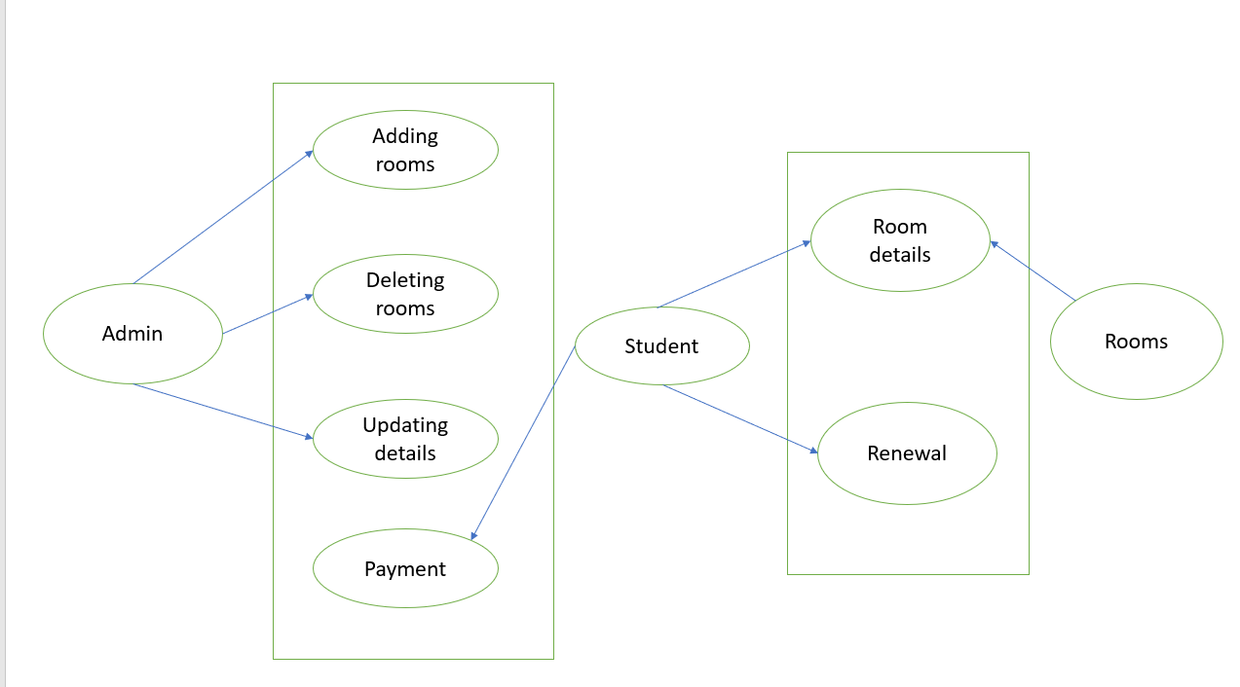
Proposed System Architecture

Slide 10
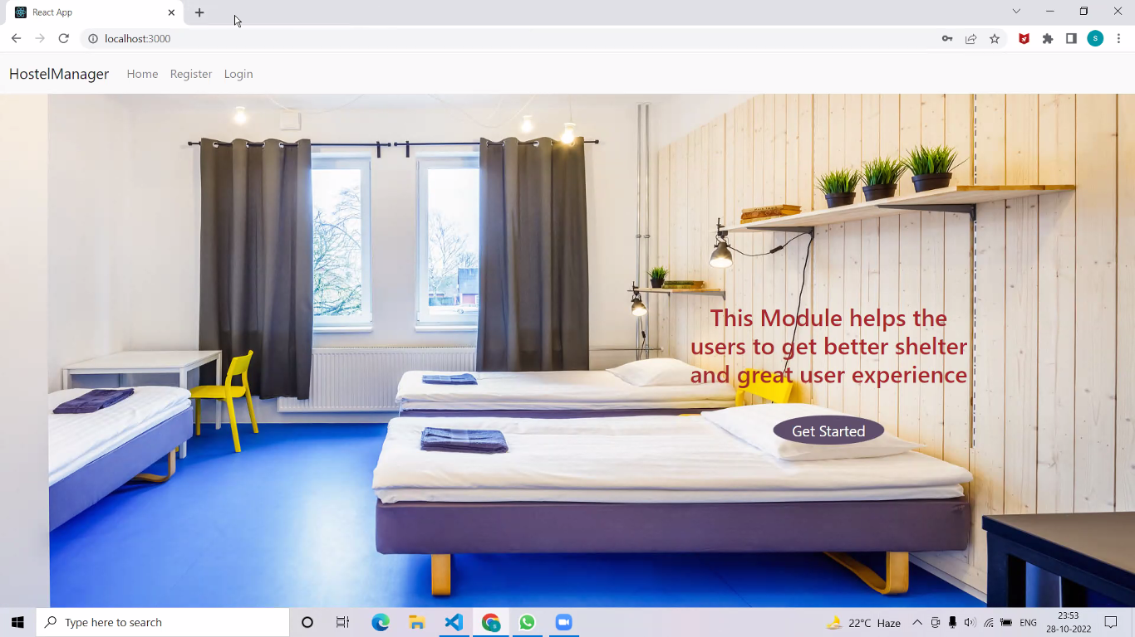
RESULTS

Slide 11
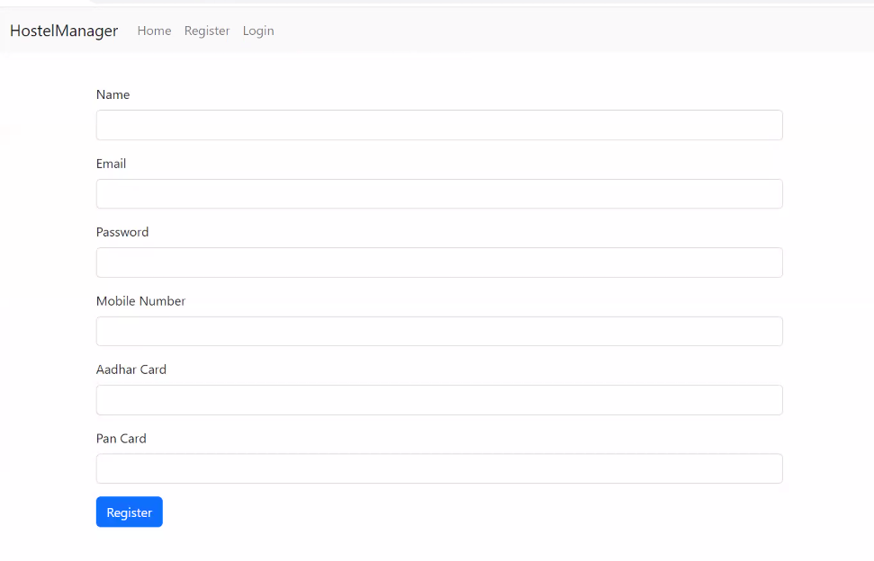
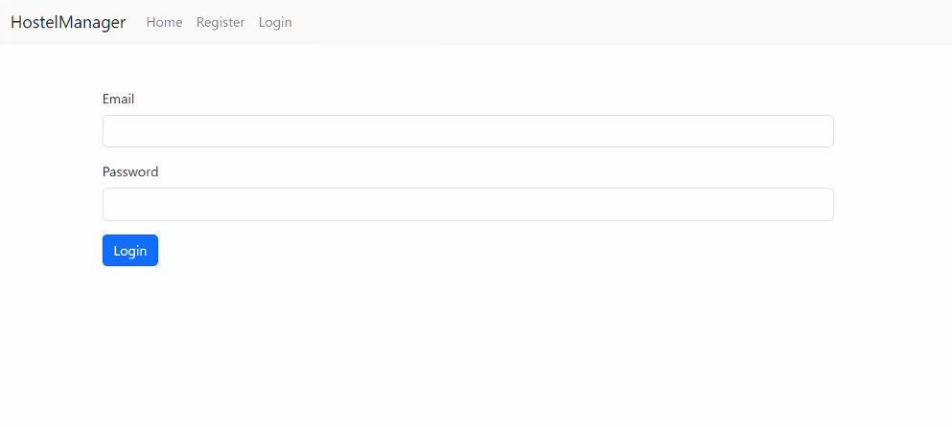
Register page
Login Page

Slide 12
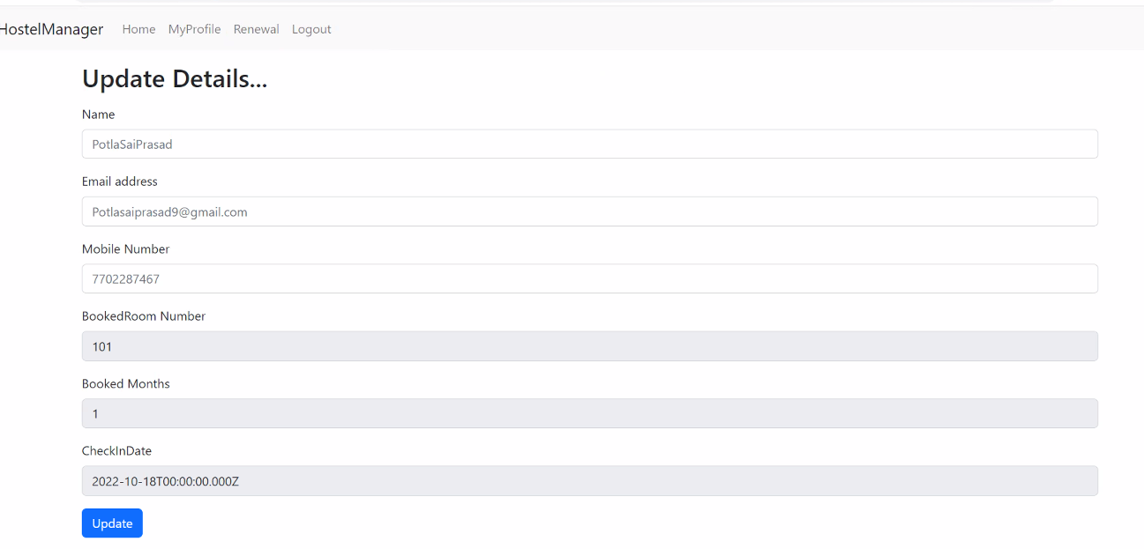
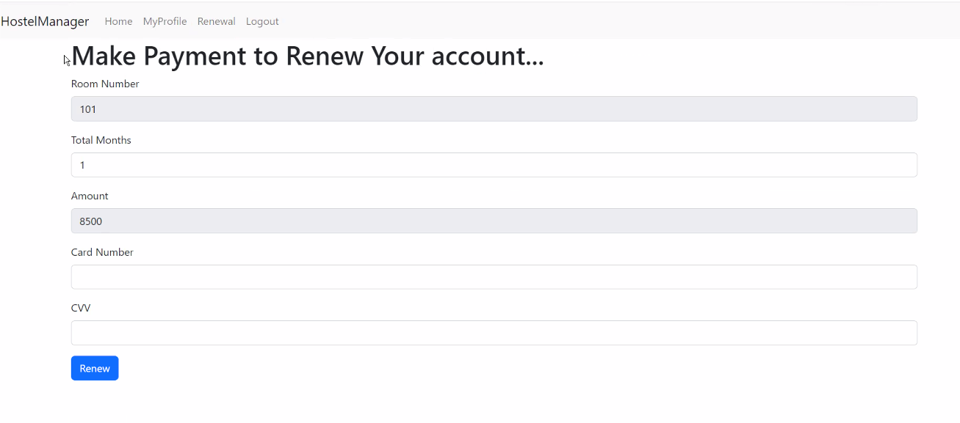
Update Details of Users Page
Payment Page

Slide 14
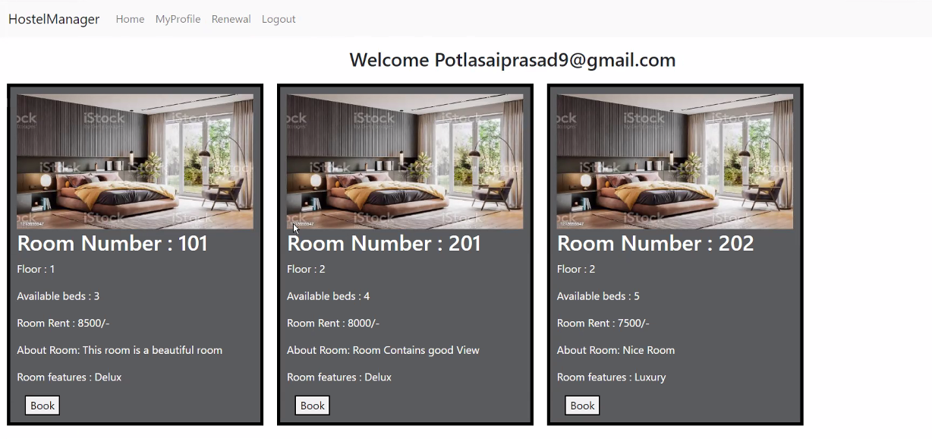
Room Details Page for Booking

Slide 15
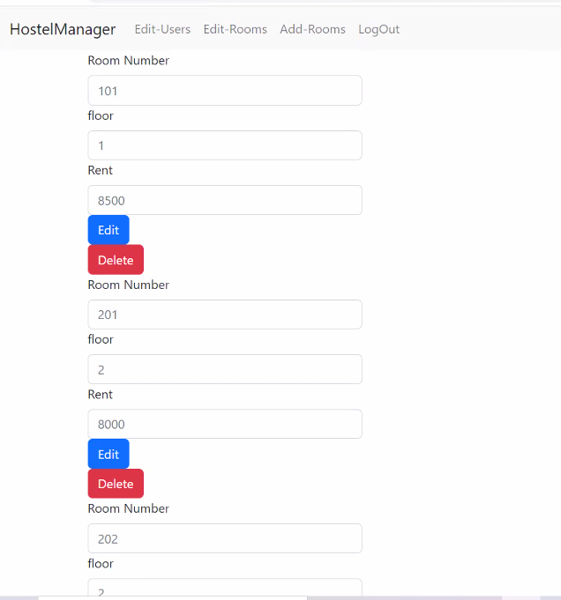
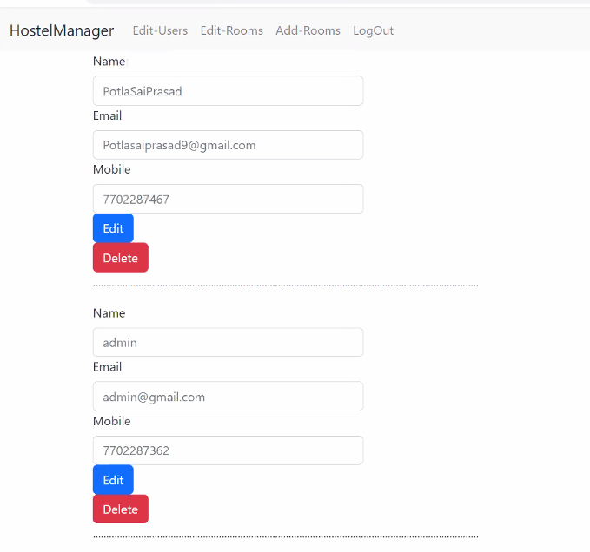
Edit Rooms Page
Edit Users Page

Slide 16
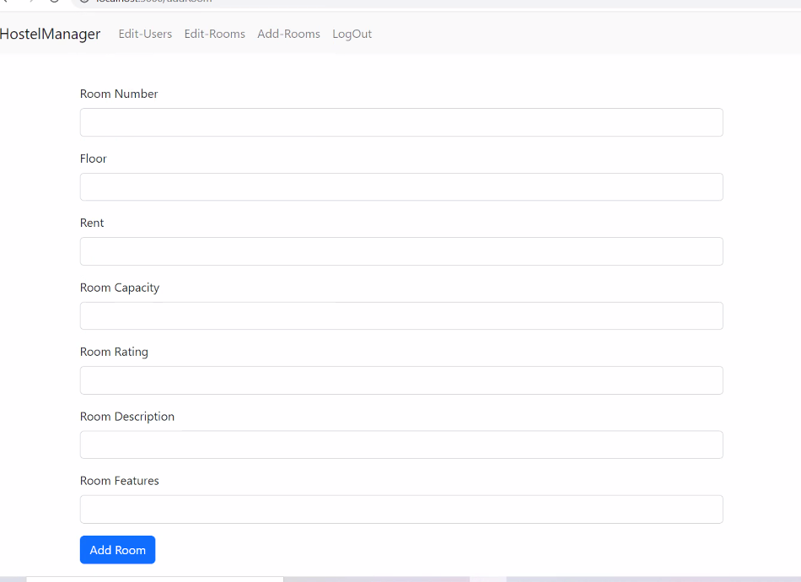
Add Rooms By Admin

Slide 17
Conclusion And Futer Work
This project developed using HTML and MongoDB is based on the requirement specification of the user and the analysis of the existing system, with flexibility for future enhancement. The expanded functionality of today’s software requires an appropriate approach towards software development. This hostel management software is designed for people who want to manage various activities in the hostel. For the past few years the numbers of educational institutions are increasing rapidly. Thereby the numbers of hostels are also increasing for the accommodation of the students studying in this institution. And hence there is a lot of strain on the person who are running the hostel and software’s are not usually used in this context. This particular project deals with the problems on managing a hostel and avoids the problems which occur when carried manually.
Identification of the drawbacks of the existing system leads to the designing of computerized system that will be compatible to the existing system with the system which is more users friendly and more GUIoriented

Slide 18



